Slide 1
Software Design for Cloud 2
Python Programming
Lecture 6
Object Oriented Programming

Slide 2
Defining Classes A new Type
class Counter:
def __init__(self, val):
self.value=val
def setValue(self,val):
self.value=val
def getValue(self):
return self.value
def decrement(self):
self.value -= 1

Slide 3
Classes Defining an Object
class Counter:
def __init__(self, val):
self.value=val
def setValue(self,val):
self.value=val
def getValue(self):
return self.value
def decrement(self):
self.value -= 1
def main():
c1=Counter(8)
print('Init Value=', c1.getValue())
c1.decrement()
print('New Value=', c1.getValue())
main()

Slide 4
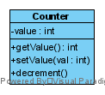
Defining Classes
class Counter:
def __init__(self, val):
self.value=val
def setValue(self,val):
self.value=val
def getValue(self):
return self.value
def decrement(self):
self.value -= 1

Slide 5
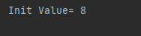
Classes Attributes are normally “public”
class Counter:
def __init__(self, val):
self.value=val
def setValue(self,val):
self.value=val
def getValue(self):
return self.value
def decrement(self):
self.value -= 1
def main():
c1=Counter(8)
print('Init Value=', c1.value)

Slide 6
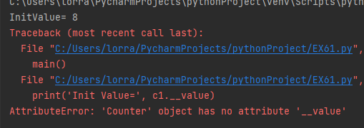
Classes “private” (Double Underscore)
class Counter:
def __init__(self, val):
self.__value = val
def setValue(self,val):
self.__value=val
def getValue(self):
return self.__value
def decrement(self):
self.__value -= 1
def main():
c1=Counter(8)
print('InitValue=', c1.getValue())
print('Init Value=', c1.__value) # Error
# can only access via getter method

Slide 7
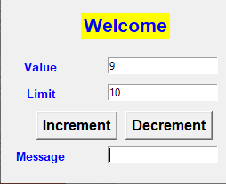
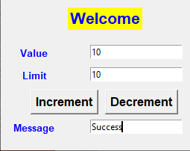
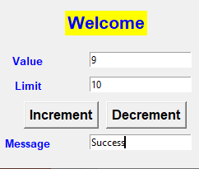
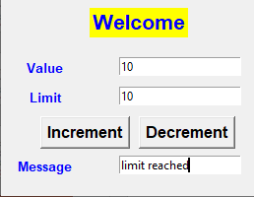
Ex61
// Add a limit attribute
// modify constructor to add limit
// add 2 methods class Counter:
class Counter:
def __init__(self, val, limit):
def increment(self):
def getLimit(self):

Slide 8
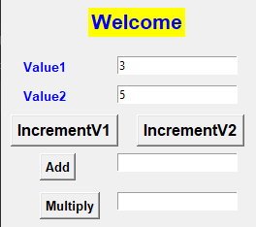

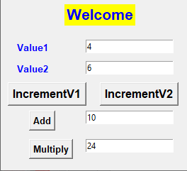

Ex62
Pair
-------------------------------------
value1 (int)
value1 (int)
--------------------------------------
__init__(int,int)
incrValue1()
incrValue2()
int getValue1()
int getValue2()
int add()# return value1+value2
int multiply()

Slide 9
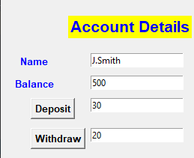



Ex63
Account
-------------------------------------
name (str) # private
balance (int) # private
--------------------------------------
__init__(int,int)
int getBalance()
str getName()
deposit(int amt)
withdraw(int amt)
# no return value, only allowed
# if amt<= balance
Withdraw only performed if sufficient funds available

Slide 10
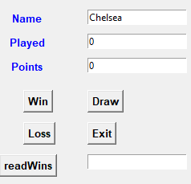
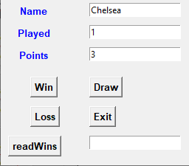
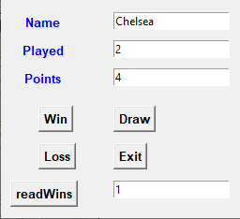

Ex64
Team
-------------------------------------
name (str)
played (int)
points (int)
wins (int) # number of wins
--------------------------------------
__init__(str)
# played, points, wins set to 0
win() # points+3, wins+1, played+1
draw() # points+1, played+1
loss() # played+1
str getName()
int getPoints()
int getPlayed()
int getWins()
3 points for a win, 1 for a draw

Slide 11
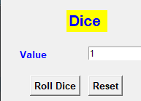
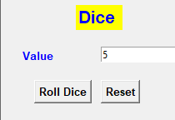


Ex65
Dice
-------------------------------------
__value () # set ti 1 initially
--------------------------------------
__init__()
# set __value to 1 initially
int getValue()
setValue(v) # set __value to v
roll() # set __value to a
# random value (1-6)
import random
def main():
n = random.randint(1,6)
print(n)
main()

